Slide 1

Spatial-temporal Programmable Metasurface for Single Channel Radiation
C. Li¹, Z. Yu¹, Y. Shen², R. Cai¹, and X. Lu¹
¹UM-SJTU Joint Institute, Shanghai Jiao Tong University
²School of Electronics and Information Technology, Sun Yat-sen University

Slide 2
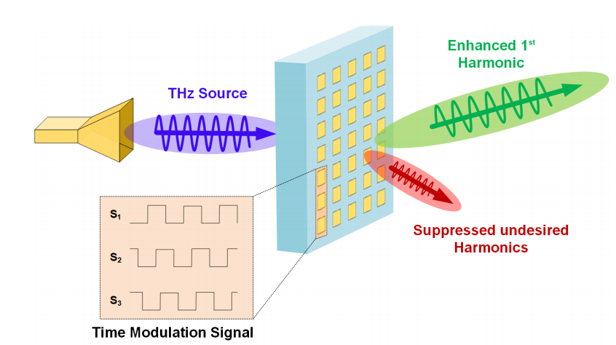
Outline
Introduction
Unit Cell Design
Harmonic Suppression Theory
Simulation Result
Conclusion and Discussion

Slide 3
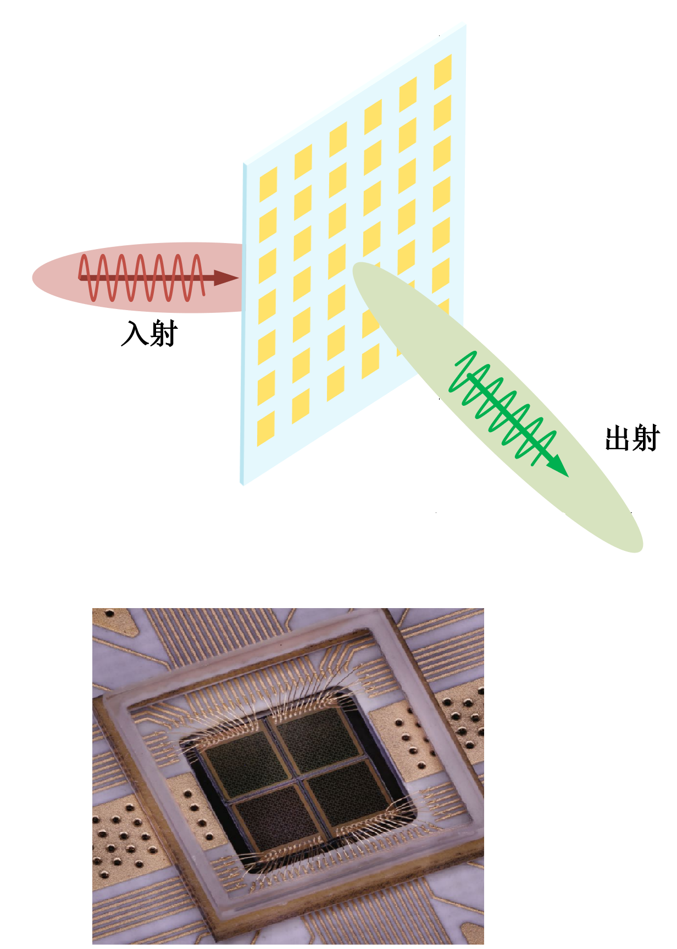
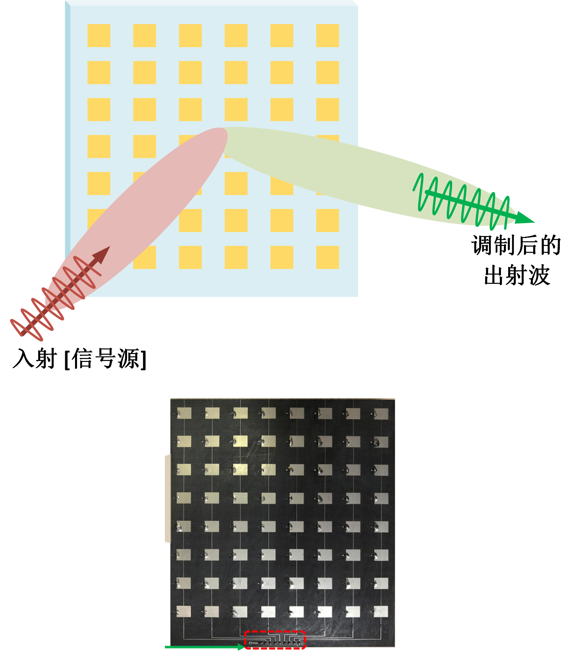
Introduction: Classification
Transmission
Reflection
Similar principle and effect
Reflection: easier to design & less control circuit requirements

Slide 4
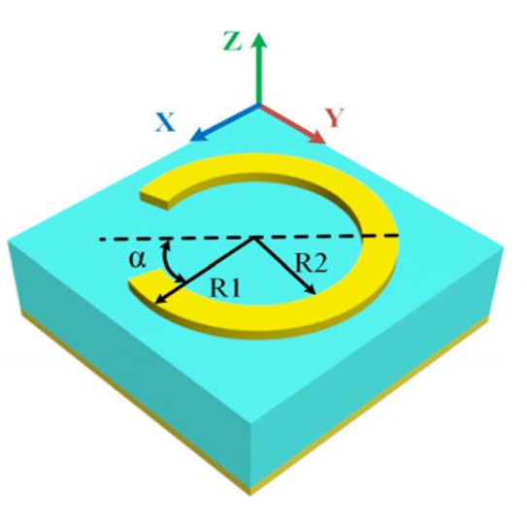
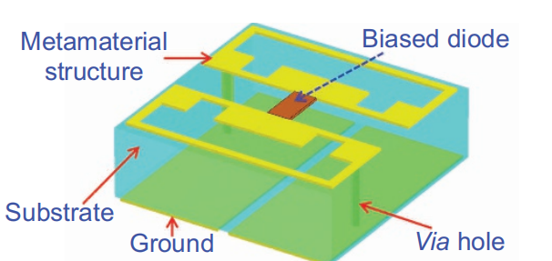
Introduction : Classification
Passive
Active
[1]
[2]
Passive: Stable, Easy to design, Fixed Scattering Pattern
Active: Flexible, Hard to design, Arbitrary Control of EM wave
High frequency performance?

Slide 5
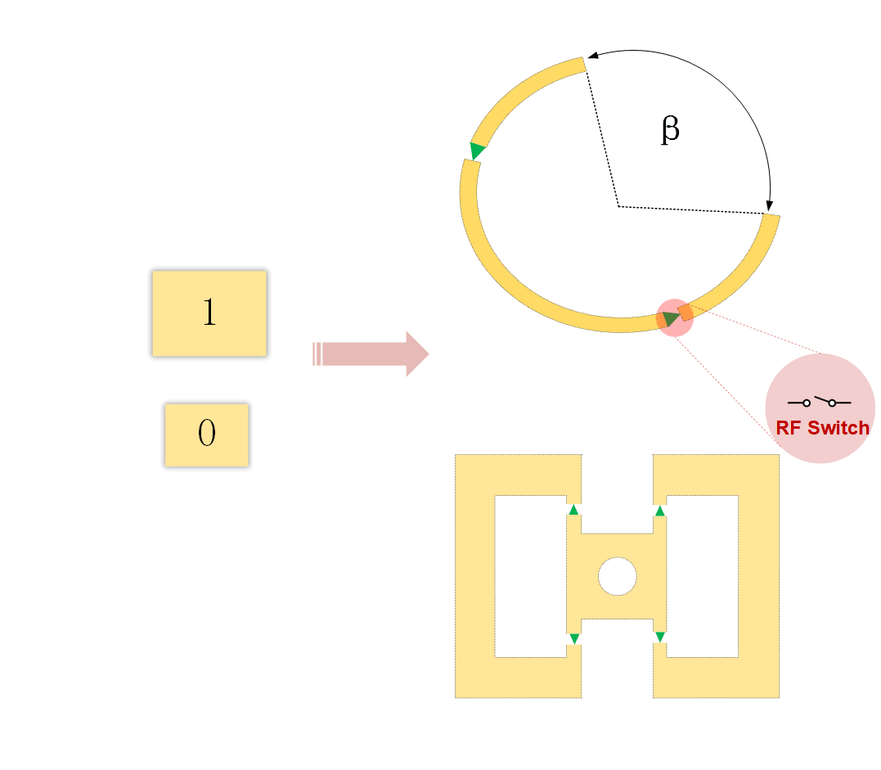
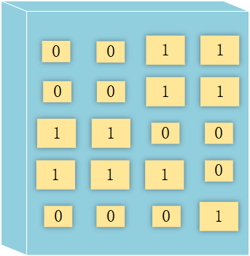
Introduction : Programmable Metasurface
Coding
Programmable
Phase, Amplitude, Polarization Modulation
Hard to achieve continuously tunable phase
Trade off: Phase granularity, radiation efficiency → Multilayer? [3]

Slide 6
Introduction : Information Metasurface
Real-time Programming
Modulate EM wave & Digital Information
Equivalent Material
Information System
→ Communication

Slide 7
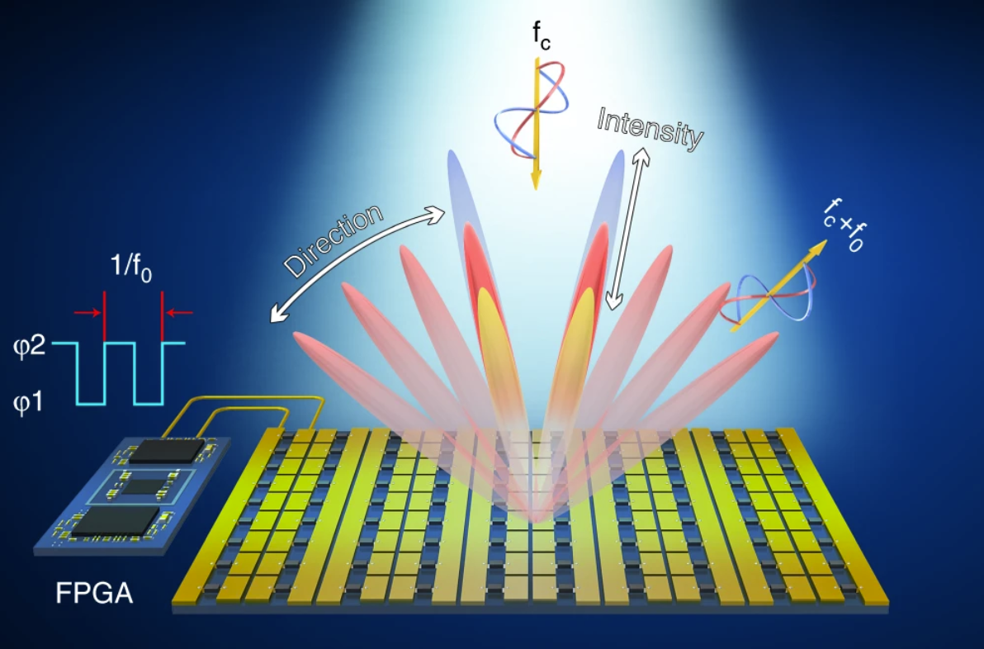
Introduction : 4-th Dimension
Achieve continuous coding
Phase & Amplitude Control
Reduce loss
Flexible Space Modulation
Time modulation → Harmonic
[4]
Harmonic ?

Slide 8
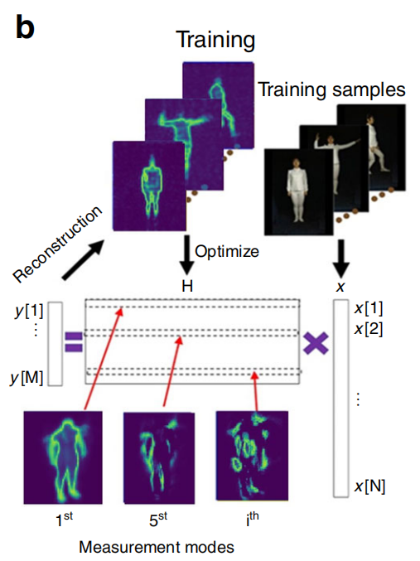
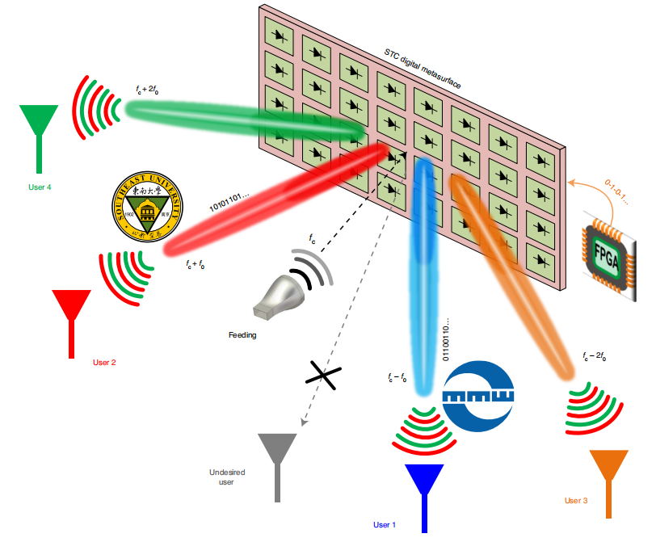
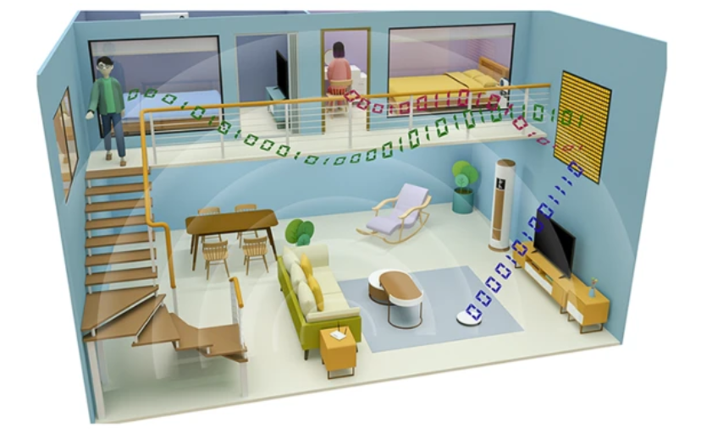
Introduction : More Applications
Metasurface Imaging
Encrypted MIMO Communication
Muti-user
[5]
[6]
[7]
Machine Learning based Imaging System
Utilization of Harmonics
Special Coding Pattern

Slide 9
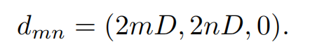
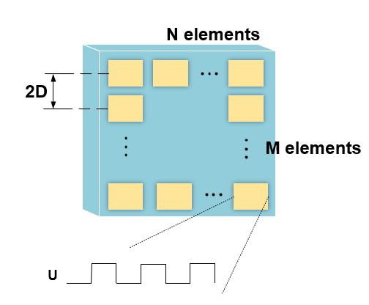
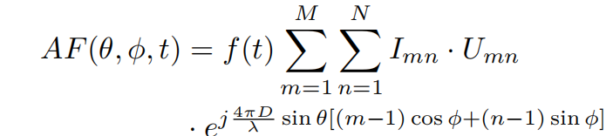
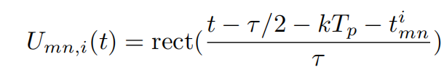
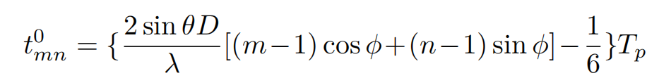
Harmonic Suppression Theory
Phased Array

Slide 10
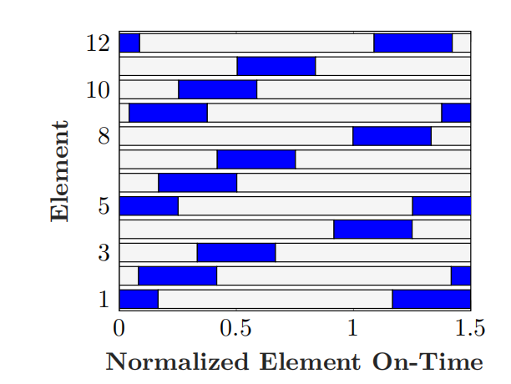
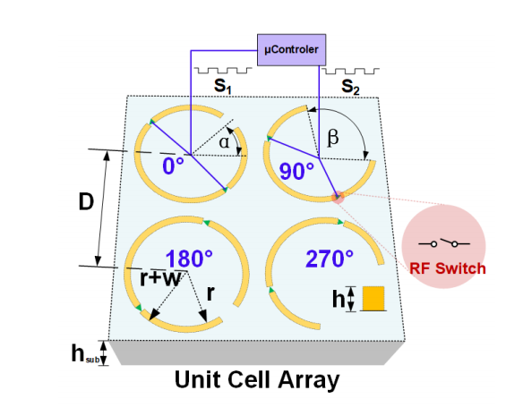
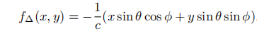
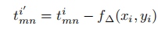
Harmonic Suppression Theory
STPM

Slide 11
Unit Cell Design
Four 1-bit elements → 5 states
Off state → Low transmittance
On states → Four different phases
(Replace phase shifters)
8 pin diodes controlled by FPGA

Slide 12
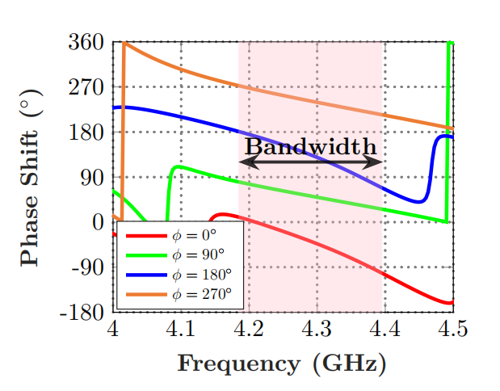
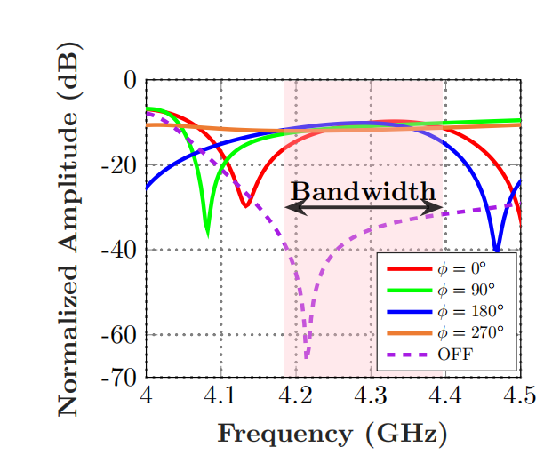
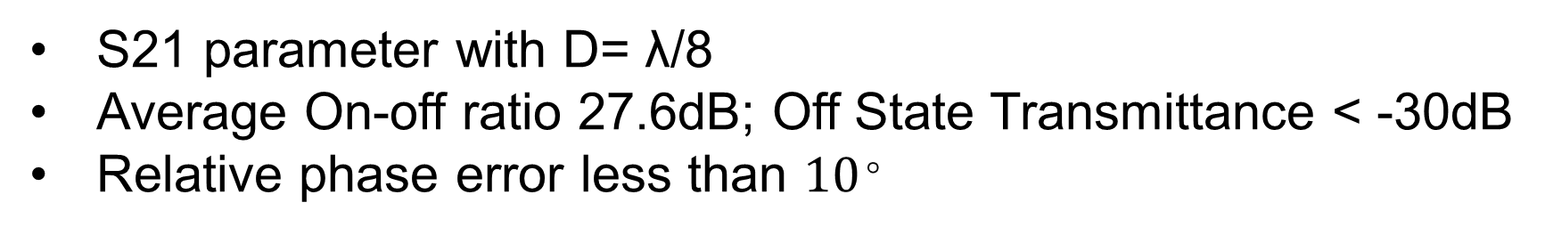
Unit Cell Design: Modulation
Phase
Amplitude
S21 parameter with D= λ/8
Average On-off ratio 27.6dB; Off State Transmittance < -30dB
Relative phase error less than ${10}^{。}$

Slide 13
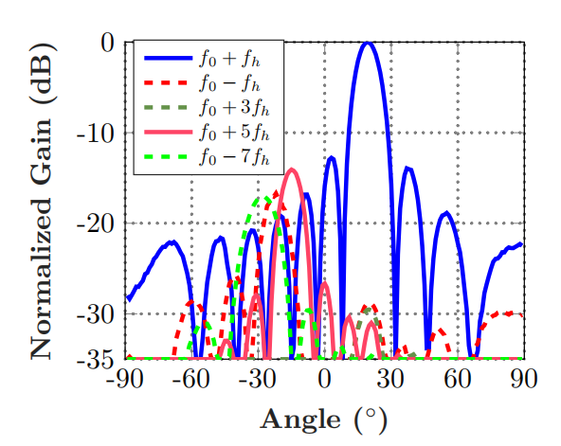
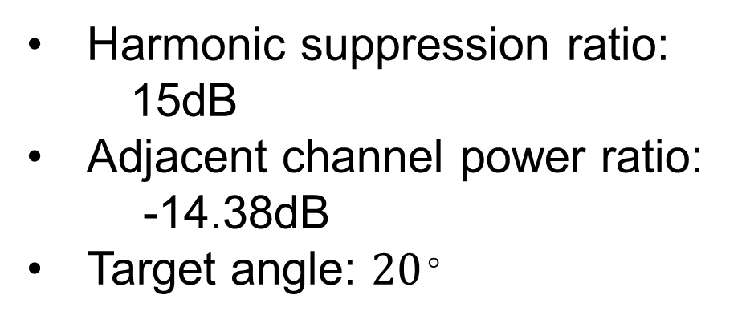
Simulation Result
Harmonic suppression ratio:
15dB
Adjacent channel power ratio:
-14.38dB
Target angle: ${20}^{。}$

Slide 14
Conclusion

Slide 15
Discussion

Slide 16
Work Cited
[1] Bao, Lei, et al. "Multi-beam forming and controls by metasurface with phase and amplitude modulations." IEEE Transactions on Antennas and Propagation 67.10 (2019): 6680-6685.
[2] Cui TJ, et al. Coding metamaterials, digital metamaterials and programmable metamaterials. Light Sci Appl. 2014;3:e218.
[3] A. H. Abdelrahman, A. Z. Elsherbeni and F. Yang, "Transmission Phase Limit of Multilayer Frequency-Selective Surfaces for Transmitarray Designs," in IEEE Transactions on Antennas and Propagation, vol. 62, no. 2, pp. 690-697, Feb. 2014, doi: 10.1109/TAP.2013.2289313.
[4] Dai JY, et al. Independent control of harmonic amplitudes and phases via a time-domain digital coding metasurface. Light Sci Appl. 2018;7:90.
[5] Li L, et al. Machine-learning reprogrammable metasurface imager. Nat Commun. 2019;10:1082.
[6] Zhang, Lei, et al. "A wireless communication scheme based on space-and frequency-division multiplexing using digital metasurfaces." Nature Electronics 4.3 (2021): 218-227.
[7] Zhao, Hanting, et al. "Metasurface-assisted massive backscatter wireless communication with commodity Wi-Fi signals." Nature communications 11.1 (2020): 1-10.
[8] T. L. Marzetta, "Massive MIMO: An Introduction," in Bell Labs Technical Journal, vol. 20, pp. 11-22, 2015, doi: 10.15325/BLTJ.2015.2407793.
[9] Q. Wu and R. Zhang, "Towards Smart and Reconfigurable Environment: Intelligent Reflecting Surface Aided Wireless Network," in IEEE Communications Magazine, vol. 58, no. 1, pp. 106-112, January 2020,
[10] C. Liaskos, S. Nie, A. Tsioliaridou, A. Pitsillides, S. Ioannidis and I. Akyildiz, "A New Wireless Communication Paradigm through Software-Controlled Metasurfaces," in IEEE Communications Magazine, vol. 56, no. 9, pp. 162-169, Sept. 2018, doi: 10.1109/MCOM.2018.1700659.
[11] Popov, Vladislav, et al. "Reconfigurable Sparse Metasurface: Beamforming Beyond Phase Gradient Heuristics." 14th European Conference on Antennas and Propagation (EUCAP 2020). 2020.
[12] Li L, et al. Electromagnetic reprogrammable coding-metasurface holograms. Nat Commun. 2017;8:197.

Slide 17

Q & A

Slide 18
Thank You!

